Slide 1
effective
COMMUNICATION
Cultivating a
hospitality culture
Notes:
Must use the FSD approved Power point template-will be provided to each trainer
Title Page: Calibri Black, 40 to 44 size font, centered
Provided by the LAUSD Food Services Division: Calibri, 24 font, centered
Date: Calibri, 12 size font
All power points should have an overview, purpose and benefits, objectives, course content, resources and questions pages.

Slide 2
AVAILABLE RESOURCES
For more information on Communication, review these trainings available on the FSD website under Human Resources: Tips & Trainings:
Communication- It Takes a Village
Effective Communication
Properly Conduct
Additionally, you can reference MyPLN to self-register for additional communication courses.

Slide 3
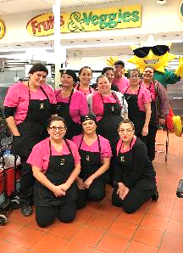
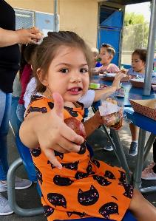
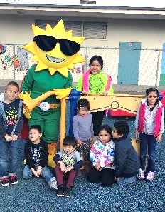
WE ARE A HOSPITALITY DIVISION
“Hospitality is the friendly and generous treatment of guests, visitors or strangers.”
Food Services acts as hosts to all those who use our services. In our cafeterias, we welcome them as guests.

Slide 4
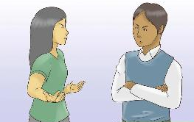
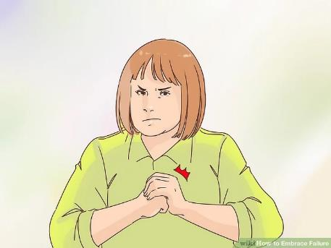
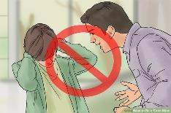
A NEW CAFÉ LA CULTURE
Change is always happening at Café LA. We are cultivating a new culture. Unfortunately, some of the old ways are still around. Let us move past the old cliché’s of the “mean lunch lady.”

Slide 5
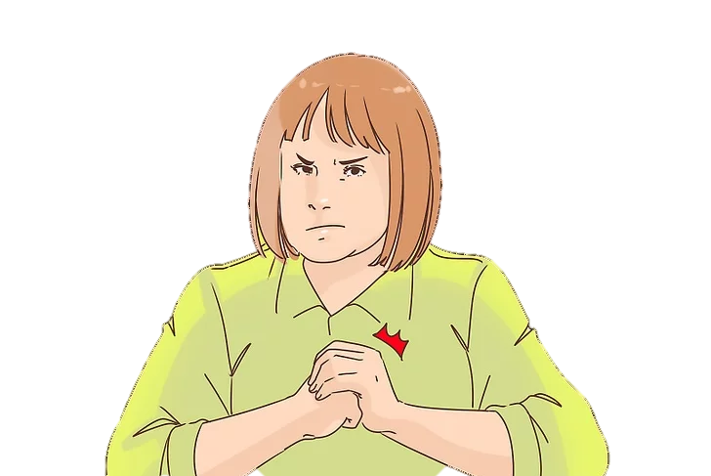
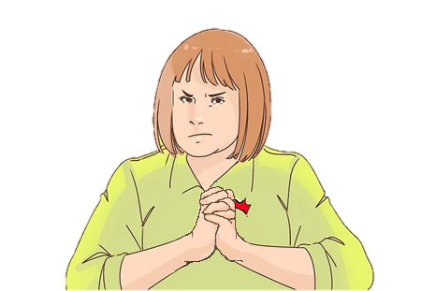
THE NEW CULTURE OF CAFÉ LA
Remember, we are cultivating a new Café LA Culture!

Slide 6
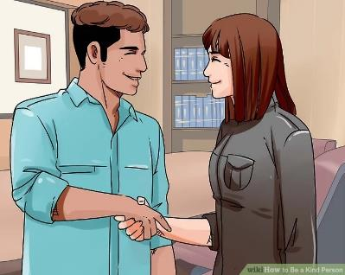
HAVE A CAMPUS PRESENCE
Café LA plays huge role on our campuses. More than ever, our managers need to collaborate with principals and teachers.
Put in some face time around campus and touch base with the tables during meal service.

Slide 7
HAVE A CAMPUS PRESENCE
Make small talk when visiting the main office
Visit the lunch pavilion during meal service
Take breaks in the faculty lounge instead of desk
Attend a teacher meeting if possible once a month

Slide 8
VALUE THE CUSTOMER
Are you familiar with the phrase, “The customer is always right.” The sentiment here is that we value our customers.
We want to show them that their opinion and their concerns are important.

Slide 9
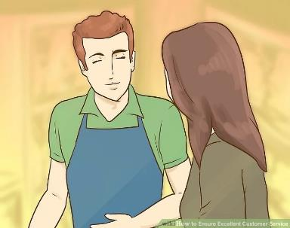
VALUE THE CUSTOMER
Speak to them kindly
Show them that you value their opinion
Avoid speaking down at customer (You’re right, they’re wrong)
Do not belittle them while speaking (both children and adults)

Slide 10
PLAYING THE VICTIM
As managers, there lies a lot of responsibility on your part. At times this can be overwhelming but it is important to understand that it is all part of the job.
You have been trusted to handle the tasks of managing your kitchens.

Slide 11
PLAYING THE VICTIM
Think positive not negative
Do not blame others when something goes wrong on your behalf
Learn from mistakes and improve
Everyone is not out to get you

Slide 12
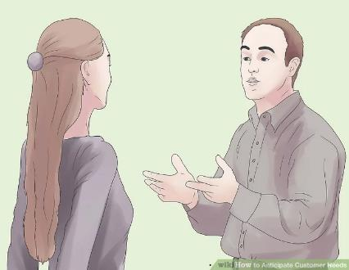
ACCEPTING CONSEQUENCES
Mistakes are inevitable when working. Sometimes it may be something that went unnoticed. Other times, it may be a behavior that needs correction.
Managers should accept responsibility so that new behaviors can be learned.

Slide 13
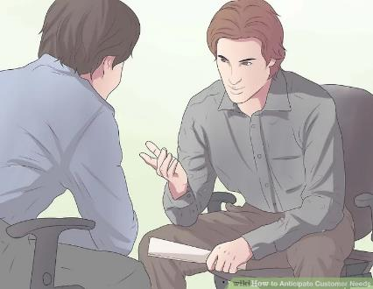
ACCEPTING CONSEQUENCES
Try not to get easily offended
Accept correction when provided by supervisor
Not everything warrants a formal complaint
If in doubt about job duties, refer to Employee Handbook

Slide 14
WORKING WITH TEAMS
As cafeteria managers, you will be required to work with other teams outside of your kitchen. Although from different departments, we are all on the same team and must work together to be successful.
We are LAUSD
Food Services
M&O, Warehouse,
Trucking, NNC
Principal, Teachers,
Parents
Beyond the Bell

Slide 15
COMMUNICATING WITH TEAMS
When communicating with different teams it is important to maintain a high degree of:
Professionalism
Approachability
Courtesy
Clarity
Service
Satisfaction

Slide 16
FLOW OF COMMUNICATION
Communication within an organization can involve different levels of employees from different departments. These patterns are called “flows” and are classified by direction:
UPWARD
DIAGONAL
HORIZONTAL
COMMUNICATION
DOWNWARD

Slide 17
UPWARD COMMUNICATION
This is staff communicating with their managers and managers communicating with their supervisors.
Encouraging upward communication can
foster cooperation, gain support, and reduce frustration among employees.
UPWARD

Slide 18
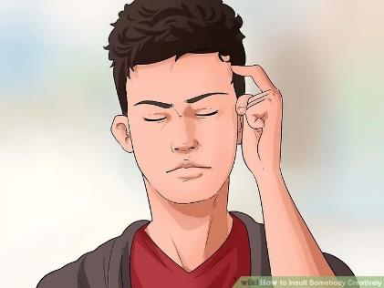
SCENARIO 4- UPWARD
Your supervisor sends you an email that the two of you will meet soon to discuss recent mistakes and missing information on your CMS report. You realize the mistakes were made during a week you were absent by your sub. How do you respond?

Slide 19
SCENARIO 4- UPWARD
ANSWER: You inform your supervisor that the mistake went unnoticed after returning to school from the week you were absent. You apologize and acknowledge that you two will meet soon to discuss recent mistakes.

Slide 20
SCENARIO 4- UPWARD
AVOID:
Getting angry or argumentative. Avoid responding emotionally or with attitude. Stay composed and act professional.

Slide 21
DOWNWARD COMMUNICATION
Supervisors or managers sharing work-related information. This follows the chain of command.
To be effective, create clearly worded communication and maintain a respectful tone.
DOWNWARD

Slide 22
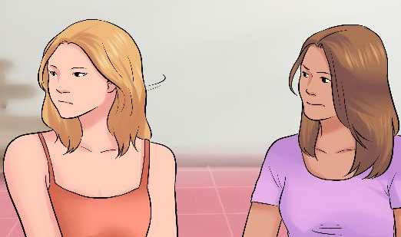
SCENARIO 2- DOWNWARD
Your employees tells you another coworker offended them. The employee tells you that their coworker said, “Don’t mess up the count again like last time, you better double count or else…” How do you respond?

Slide 23
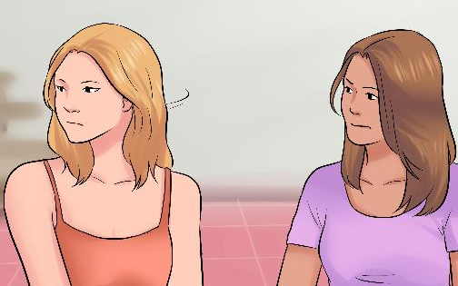
SCENARIO 2- DOWNWARD
ANSWER: You tell the employee that it is never acceptable to use threatening language. You explain that it is better to offer to help or assist, than to tease them about making a mistake.

Slide 24
SCENARIO 2- DOWNWARD
AVOID: Participating in the teasing or threatening of the employee. Do not take sides or make one side feel uncomfortable.

Slide 25
HORIZONTAL COMMUNICATION
The flow of messages across individuals and groups on the same level of an organization.
Horizontal communication can enhance productivity, information sharing, collaboration, and conflict resolution.
HORIZONTAL

Slide 26
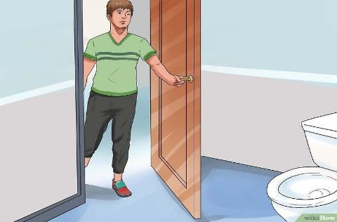
SCENARIO 1- HORIZONTAL
A teacher likes to enter your kitchen from the side door when they arrive to school. Rather than going around, they like to walk through the kitchen to get on campus. How do you respond?

Slide 27
SCENARIO 1- HORIZONTAL
ANSWER: You explain to the teacher that only food service employees are allowed in the kitchen and that it is a safety concern. Remind them to use the same route as the rest of the teachers.

Slide 28
SCENARIO 1- HORIZONTAL
AVOID:
Reacting abruptly or rude such as yelling,
“YOU CANT BE IN HERE, GO AROUND!”
Do not act aggressive or harsh.

Slide 29
DIAGONAL COMMUNICATION
Cross-functional communication between employees at different levels of the organization.
An example of this is a manager communicating with a supervisor of another department, not their own.
DIAGONAL

Slide 30
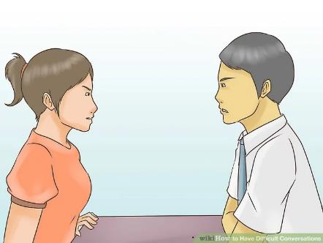
SCENARIO 3- DIAGONAL
At 3:00pm your principal tells you a teacher forgot about their field trip for tomorrow and they need lunch. You and your principal don’t have a great working relationship but you and the teacher do. How do you respond?

Slide 31
SCENARIO 3- DIAGONAL
ANSWER: You explain to the principal that it is the end of the day and you are unable to make anything. Also, you remind the principal to instruct teachers to follow procedure for their convenience.

Slide 32
SCENARIO 3- DIAGONAL
AVOID:
Responding with “NO” without providing a reason. Avoid showing favoritism among the teachers. Treat all teachers equally to show fair treatment.

Slide 33
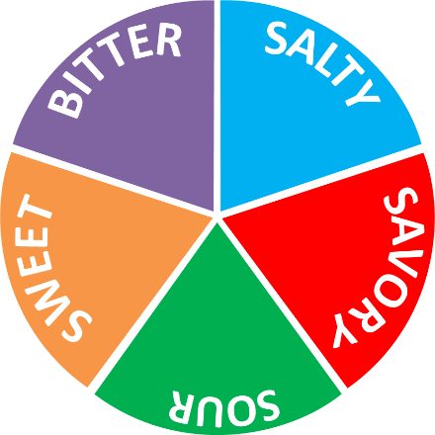
CONVERSATION FLAVORS
Conversations can range from difficult to pleasant. It is good to assess the direction of conversation.
Based on the direction the conversation is heading, you can redirect using certain language, tone and other keywords.

Slide 34
SWEET CONVERSATIONS
These are conversation that you look forward to having. Often times these are easy and happen between you and someone you easily get along with.
Pleasant
Easily Understood
Leave Happy
Message is Received

Slide 35
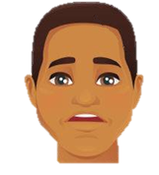
SAVORY CONVERSATIONS
These conversations result in the receiver agreeing with the message, but only out of courtesy. Receiver is not combative or rude, and message is received apathetically.
Agreeable
Compliant
“Eh, okay”
“No problem”

Slide 36
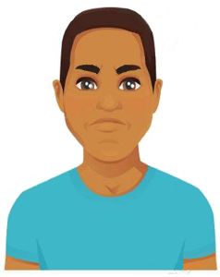
SALTY CONVERSATIONS
These conversations are difficult ones that are not well received. They occur when subject matter may be sensitive and causes an unfavorable reaction.
Attitude
Eye rolls
Defiant
Negative Body Language

Slide 37
SOUR CONVERSATIONS
These conversations are not received positively and with no enthusiasm. The receiver disapproves and shows no interest.
Negative
Unconstructive
Unenthusiastic
Message perceived as disapproving

Slide 38
BITTER CONVERSATIONS
These conversations cause the receiver to be combative and defensive. Usually when providing correction or confronting behavior, receiver becomes angry.
Argumentative
Confrontational
Aggressive
Challenging

Slide 39
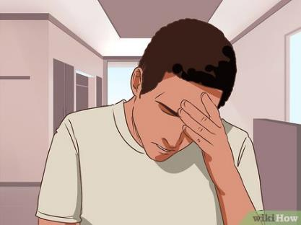
CRITICAL COMMUNICATION
There are times when communication must take place under undesirable conditions. Our communicative skills will be most useful during these occurrences:
Stressful situations
Confronting danger
Time sensitive issues
Emergencies

Slide 40
CRITICAL COMMUNICATION
During these situations, “How” we communicate is of great importance. Consider utilizing the following when crucial conversations must take place:
A calm demeanor
Speaking clearly
Being honest when unclear of information
Maintain a good perspective

Slide 41
TAKING IT PERSONAL
Considering something as a direct attack against you; being offended, upset, or negatively affected by something personally.

Slide 42
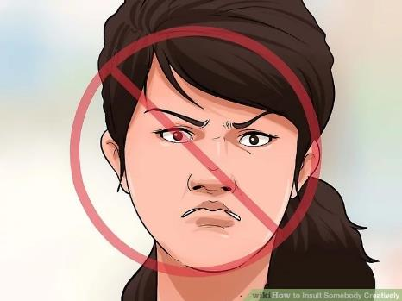
TAKING IT PERSONAL
Taking it personal results in a bruised ego. Communicative issues can be reduced by not taking it personal. When working with others, maintain a level of professionalism without involving ego or personal feelings.

Slide 43
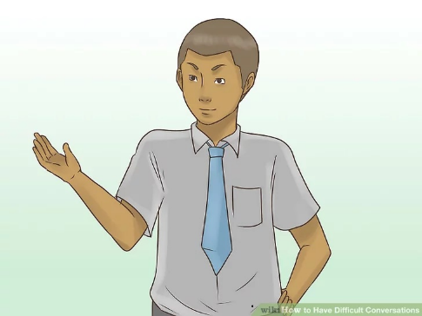
TAKING IT PERSONAL
At your managers meeting your supervisor mentions that a few managers weren’t completing monthly tasks. As your supervisor is discussing this, they glance over towards you and the two of you meet eye to eye.

Slide 44
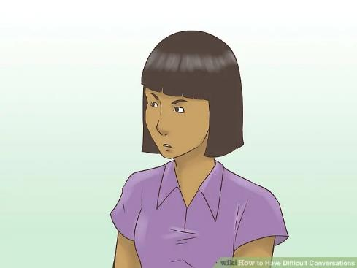
TAKING IT PERSONAL
You immediately take offense to this even though they were not talking about you. You abruptly shout out, “NOT ME, WHY DID YOU LOOK AT ME? I FINISHED ALL MY TASKS!”

Slide 45
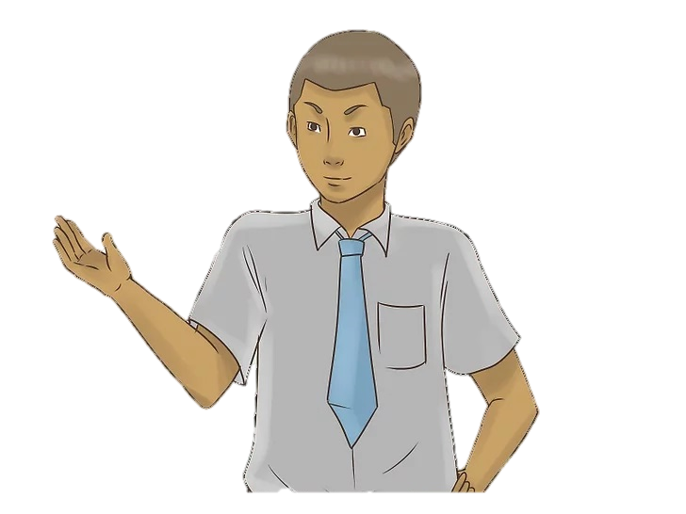
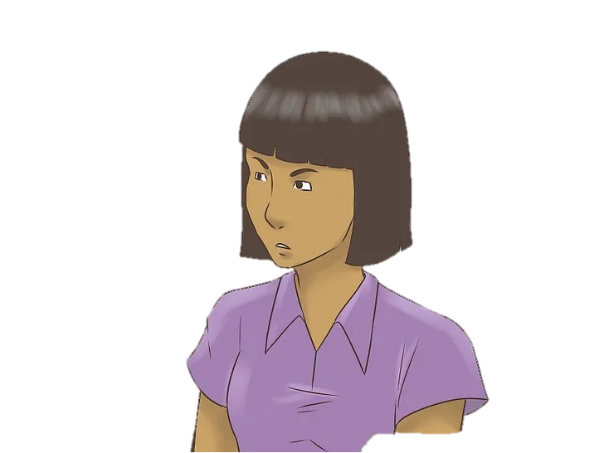
TAKING IT PERSONAL
TAKING IT PERSONAL:
Assuming that your supervisor is talking about you just because they looked towards you. You believe they are attacking you in front of everyone.

Slide 46
TAKING IT PERSONAL- EX:1
NOT TAKING IT PERSONAL:
Avoid receiving comments as a directed towards you if you know your work is completed. If you are unsure, after the meeting, ask supervisor to clarify.

Slide 47
REDIRECTING CONVERSATIONS
Conversations can start one way and end in another. When having a conversation that turns sour or bitter, consider the following steps to redirect conversation:
Opposition to Partnership
Verbalize your Intention
Avoid Assumptions
Consider others Perspective

Slide 48
OPPOSITION TO PARTNERSHIP
When having a difficult conversation, it is easy to see your conversational partner as your opponent. Consider them as your partner, not your enemy:
Reposition the way you are speaking
No longer “You vs Them”
Tackle the problem collaboratively
Consider offering help

Slide 49
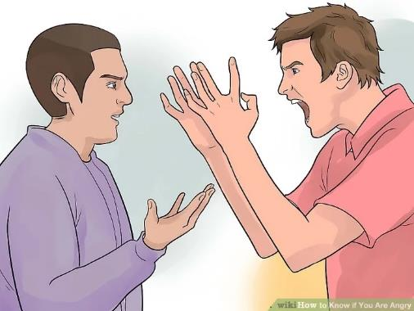
OPPOSITION TO PARTNERSHIP
EX: A teacher is constantly late to return their BIC cart to cafeteria. You approach the teacher about returning their BIC bag in time.

Slide 50
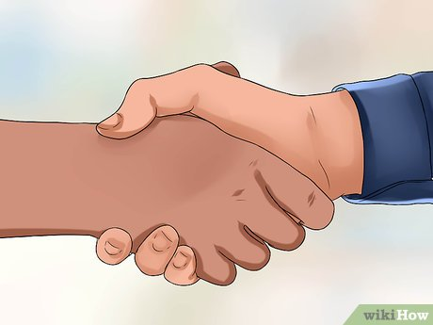
OPPOSITION TO PARTNERSHIP
Instead of “You vs. Them,” reposition the way you speak to them. Speak to them as though the two of you are partners in solving a problem.

Slide 51
VERBALIZE YOUR INTENTION
Make sure to be open and transparent about what you are discussing. Share your purpose and what you hope to achieve with your conversation.
Be clear and thorough
Explain reason for any action
Keep conversation on topic
Concentrate on main reason

Slide 52
VERBALIZE YOUR INTENTION
EX: You approach your employee who keeps making the same mistake. You start the conversation by clearly stating that the point of the conversation is to narrow down where the error may be occurring.

Slide 53
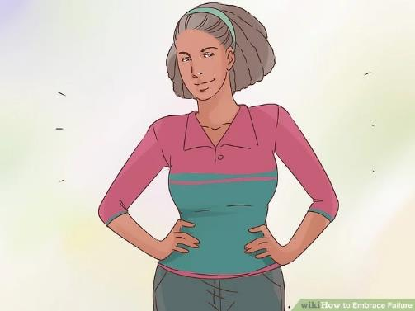
VERBALIZE YOUR INTENTION
This way, your employee knows that this conversation is not an attack. Instead, the conversation turns into a plan to prevent the mistake from happening again.

Slide 54
AVOID ASSUMPTIONS
When we make assumptions about another persons intentions, this usually reveals more about what we are thinking rather than what the other person is saying.
Assumptions limits understanding
Reduces probability of problem solving
Narrows range of solutions
Creates more problems

Slide 55
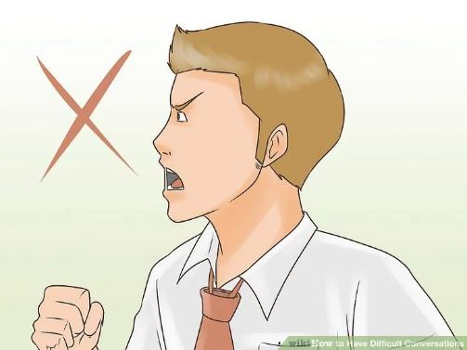
AVOID ASSUMPTIONS
EX: You recently started serving Hot Supper at your site. Your supervisor tells you to go to another school to observe how the manager there is implementing Supper.

Slide 56
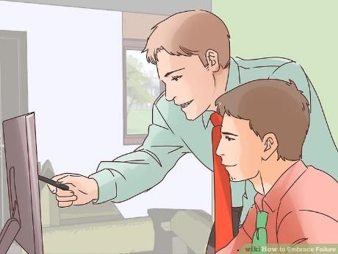
AVOID ASSUMPTIONS
Instead of assuming your supervisor thinks you are doing something wrong, consider it as an opportunity to observe another site and get new ideas or even help out your fellow manager.

Slide 57
CONSIDER OTHER’S PERSPECTIVE
To better understand the perspective of your conversational partner, switch off defense mode and turn on curiosity mode. Try speaking less and listening more.
Ask open ended questions
Listen and hear them out
Allow them to express themselves
Avoid one-sidedness

Slide 58
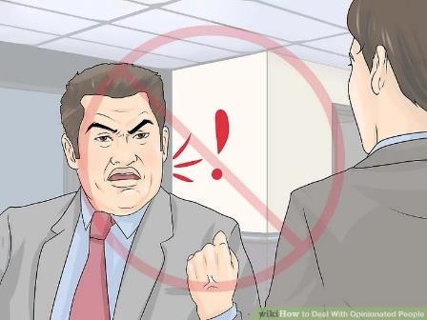
CONSIDER OTHER’S PERSPECTIVE
EX: You realize there is a problem with the daily production schedule. Your senior quickly identifies the problem but, stays quiet because you start becoming agitated and begin yelling.

Slide 59
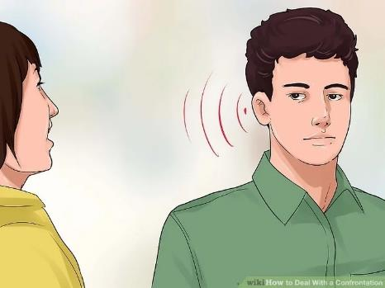
CONSIDER OTHER’S PERSPECTIVE
Instead, calmly approach your senior and give them the opportunity share what they think may help the situation. Ask questions, together you can solve the problem.

Slide 60
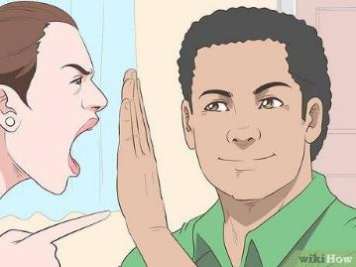
REDIRECTING RECAP
If a conversation starts turning sour and heading into the wrong direction, remember to use methods to increase conversational effectiveness:
Opposition to Partnership
Verbalize your Intention
Avoid Assumptions
Consider other’s Perspective

Slide 61
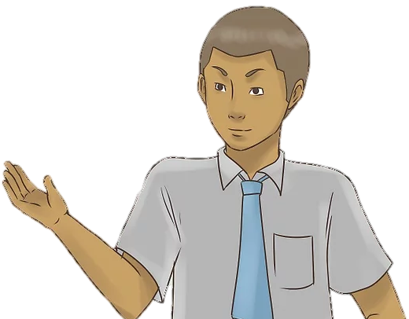
CULTIVATING A NEW CULTURE
We are moving in a great new direction. The way we communicate with those we work with everyday will now be more important than ever.
WE ARE CAFÉ LA!!

Slide 62
As a Reminder
You are required to review all assigned documents. By completing this training you are certifying you have viewed all the required documents and this training in its entirety.
LAUSD Food Services Division
Nourishing Children to Achieve Excellence
Notes:
TELL: Thank you for joining me today. As a reminder, you are required to review all assigned documents. By completing this training you are certifying you have viewed all the required documents and this training in its entirety.

